Slide 1


MUSIC GENRE CLASSIFICATION USING CNN

Slide 2
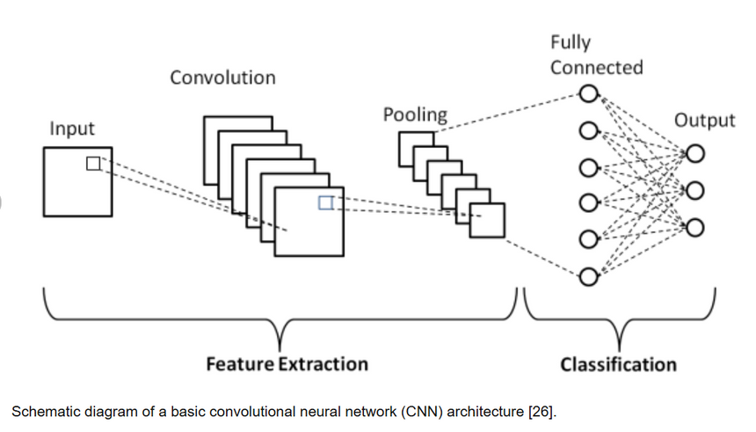
MUSIC GENRE CLASSIFICATION USING CNN NETWORK
Objective: Classify music tracks into different genres using deep learning techniques.
Key Steps:
Preprocessed raw audio data for analysis.
Extracted 13 MFCC features and stored them in JSON format.
Designed and trained a CNN model for genre classification
Tools and Technologies: Python, TensorFlow/Keras, Librosa, JSON.
Key Outputs:Predicted Genre Example: (e.g., Pop, Rock, Jazz).

Slide 3
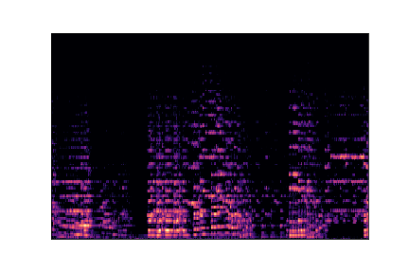

OUTPUT
MFCC SPECTROGRAM IMAGE OF CLASSICAL
OUTPUT OF THE CNN MODEL

